Slide 1

Introductory Computer Networking and IT Security
Week 4

Slide 2
Agenda
Introduction to routing
Command line interface
Router user interface
Static Routing and Dynamic routing
Introduction to RIP v1 and v2
Static and dynamic routing (EIGRP & OSPF)

Slide 3
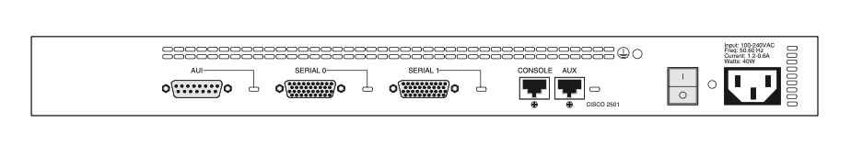
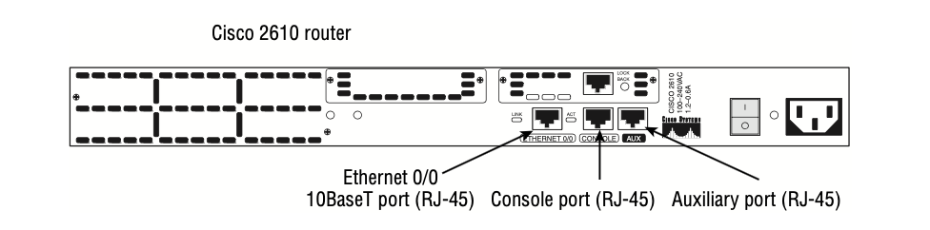
Introduction To Routing
Routing is the process of selecting best paths in a network
In simple words: Routing is building maps and giving directions
Cisco 2501 router

Slide 4
To route a router need to know:
  Remote Networks
  Neighbor Routers
  All Possible routes to remote network
  The absolute best route to all remote networks
  Maintain and verify the routing information

Slide 5
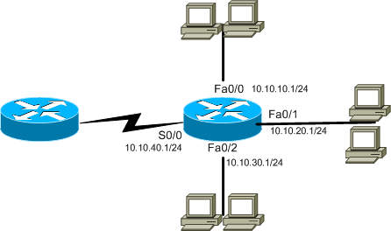
Introduction To Routing
Best path Selection
  What interface will the router send out a packet if it has destination address of 10.10.10.18?

Slide 6
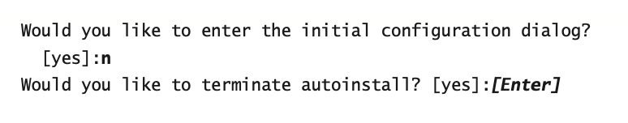

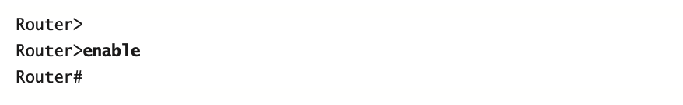
Command-Line Interface
Logging into the router

Slide 7
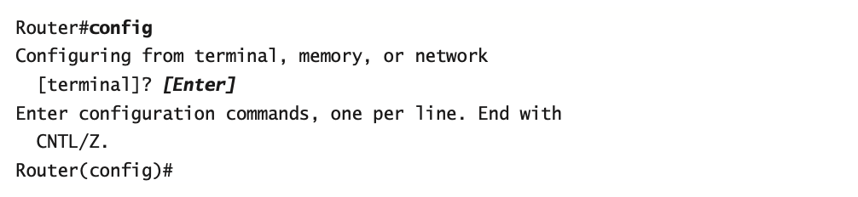
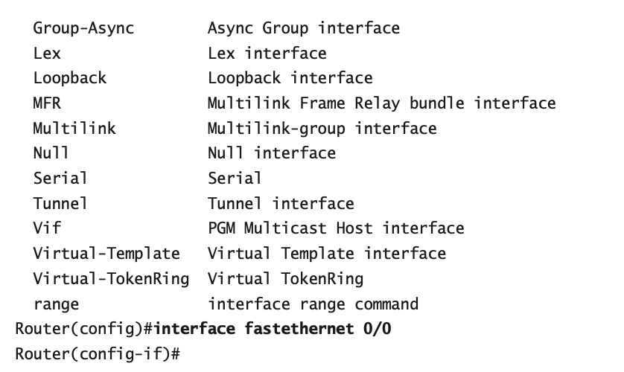
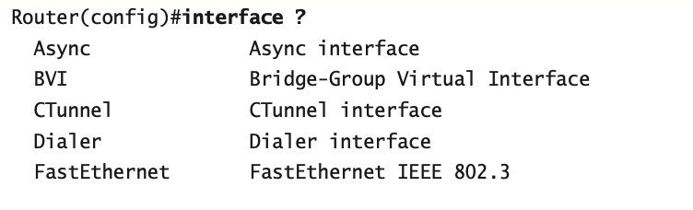
Overview of Router Modes
Interfaces

Slide 8
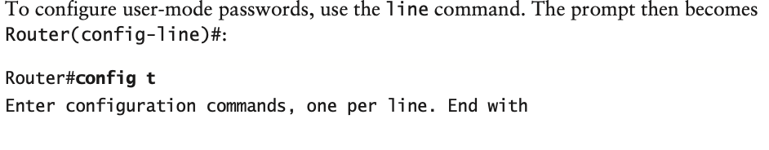
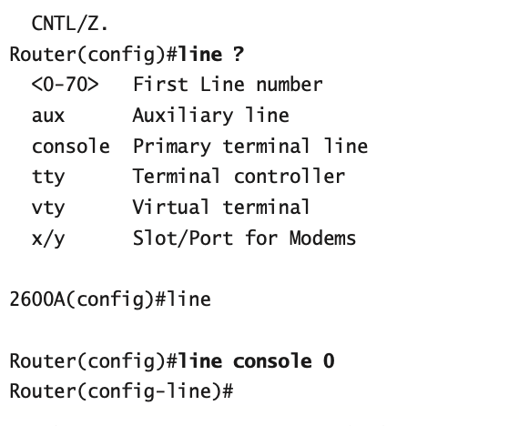
Sub interfaces
Line Commands

Slide 9
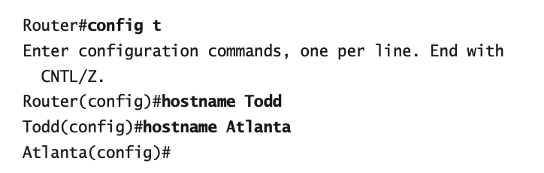
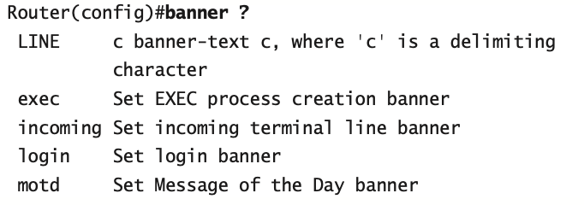
Router and Switch Administrative Functions
Hostnames
Banners

Slide 10
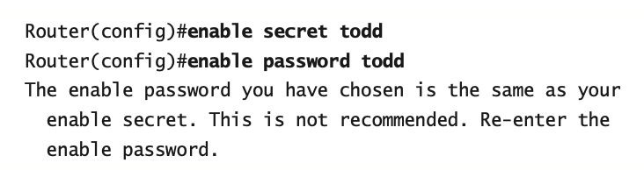
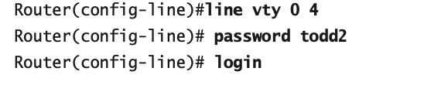
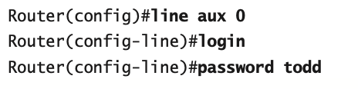
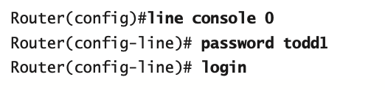
Setting Passwords
Enable Passwords
Telnet Password
Auxiliary Password
Console Password

Slide 11
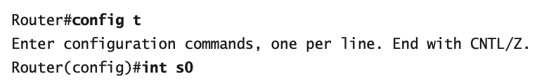

Router Interfaces
Configuring an IP Address on an Interface
Serial Interface Commands

Slide 12
Introduction To Routing
What happens when a router receives a packet for a network that isn’t listed in the routing table? It doesn’t send a broadcast looking for the remote network—the router just discards it.
Static routing
Default routing
Dynamic routing

Slide 13
Static Routing
  Manually configured routes are placed into routers routing table.
  Suitable for smaller networks.
  A network administrator, with knowledge of the internetwork topology, manually builds and updates the routing table, programming all routes in the routing table.

Slide 14
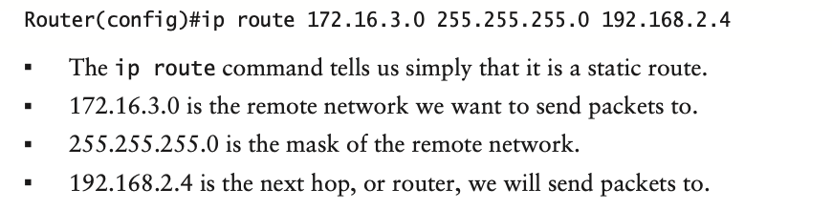
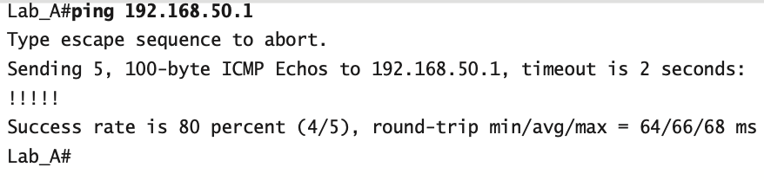
Static Routing
ip route [destination_network] [mask] [next-hop_address or exitinterface] [administrative_distance] [permanent]
Verifying Your Configuration

Slide 15
Default Routing
default routing is used to send packets with a remote destination network not in the routing table to the next-hop router.
default routing can be used only on stub networks—those with only one exit path out of the network.
to configure a default route, you use wildcards in the network address and mask locations of a static route.

Slide 16
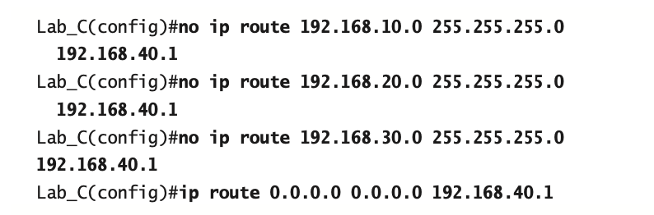
Default Routing

Slide 17
Dynamic Routing
  Routing table on a router is maintained with the help of routing protocols.
  Routing protocols automatically communicates with each router and update routing table automatically.
  Types of Routing Protocols
    Interior Gateway Protocol (IGP)
    Exterior Gateway Protocol (EGP)

Slide 18
Interior Gateway Protocol (IGP)
Routing table on a router is maintained with the help of routing protocols.
Within an Autonomous System
  Autonomous system is collection of networks with same routing policy
Carries information about internal infrastructure prefixes
Example: RIP,OSPF, ISIS, EIGRP

Slide 19
Exterior Gateway Protocol (EGP)
Used to convey routing information between Autonomous Systems.
Example: BGP

Slide 20
  Distance vector routing protocol (RIP, IGRP)
  Distance vector algorithms do not allow a router to know the exact topology of an internetwork.
  All routers just broadcast their entire routing table out all active interfaces on periodic time intervals.

Slide 21
Routing Information Protocol (RIP)
  Hop count metric selects the path, 16 is unreachable
  Full route table broadcast every 30 seconds
  Load balance maximum of 6 equal cost paths (default = 4)
  Uses Bellman Ford algorithm for path selection
  RIPv1 uses broadcast for routing table update

Slide 22
Routing Information Protocol (RIP)
Routing Information Protocol
    RIPv1 RIPv2
    Classful Classless
    Broadcast for updates Multicast for updates
    Does not supports authentication Supports authentication

Slide 23
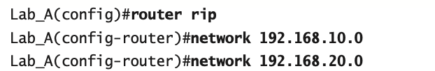
Sample RIP Configuration
Router(config)#router rip
Router(config-router)#network network-number*
10.3.5.0
172.16.10.0
192.168.10.0
router RIP
router RIP
network 172.16.0.0
network 10.0.0.0
network 172.16.0.0
network 192.168.10.0

Slide 24
Interior Gateway Routing Protocol (IGRP)
Works only on Cisco routers. Cisco created this routing protocol to overcome the problems associated with RIP.
IGRP has a maximum hop count of 255 with a default of 100. This is helpful in larger networks and solves the problem of 15 hops being the maximum possible in a RIP network.
IGRP uses bandwidth and delay of the line by default as a metric for determining the best route to an internetwork. This is called a composite metric.
uses an autonomous system (AS) number.

Slide 25
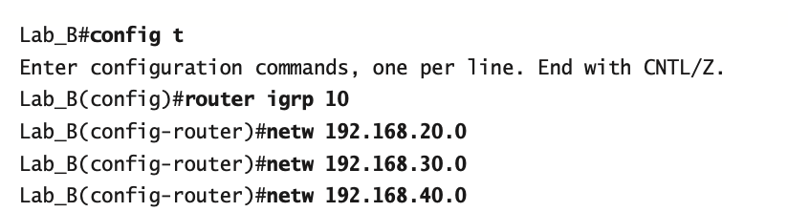
Sample IGRP Configuration
Router(config)#router igrp <autonomous system (AS) number >
Router(config-router)#network network-number*

Slide 26
  Link State routing protocol (OSPF)
  Link-state protocols, also called shortest-path-first protocols
  Each router creates three separate tables. One of these tables keeps track of directly attached neighbors, one determines the topology of the entire internetwork, and one is used as the routing table
  Link-state routers know more about the internetwork than any distance-vector routing protocol ever could.

Slide 27
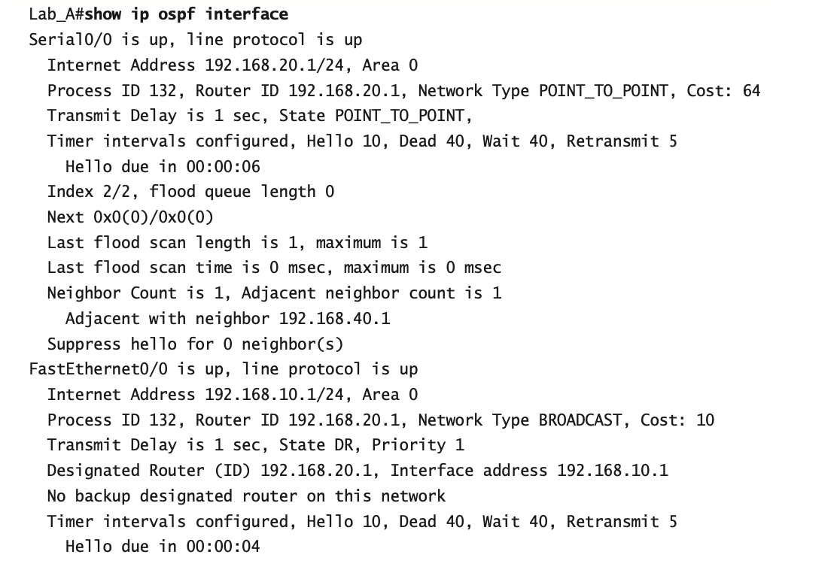
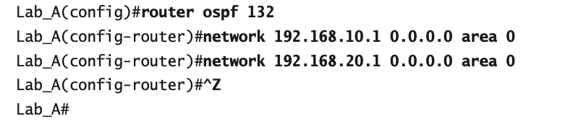
Configuring OSPF

Slide 28
  Hybrid routing protocol (EIGRP)
Hybrid protocols use aspects of both distance-vector and link-state protocols
EIGRP is the hybrid routing protocol
EIGRP is Cisco proprietary

Slide 29
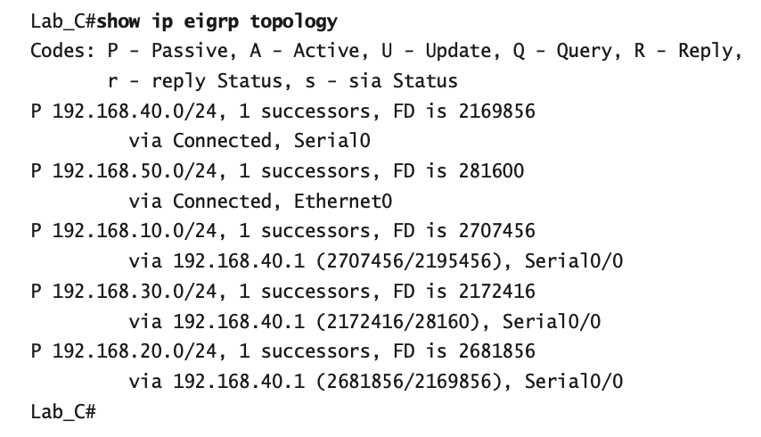
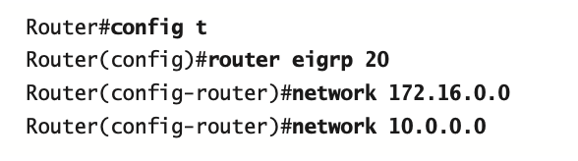
Configuring EIGRP

Slide 30
Static vs Dynamic Routing
  There is no overhead on the router CPU on static routing as compared to dynamic routing
  It adds security because you, the administrator, can be very exclusive and choose to allow routing access to certain networks only. Dynamic routing is more automatic
  There is no bandwidth usage between routers, saving you money on WAN links. Dynamic routing need to update routing table

Slide 31
Static vs Dynamic Routing
Dynamic routing is scalable in large network but not static routing
Whoever the administrator, is must have a vault-tight knowledge of the internetwork in static routing, so difficult to maintain

Slide 32
Summary
Routing configuration
Command line configuration
Static routing
Default routing
Dynamic routing

Slide 33
ANY QUESTION??

Slide 34
THANK YOU

